Slide 1

HACKVOUCHER
DEPARTMENT OF COMPUTER SCIENCE AND ENGINEERING
Under the guidance of : Presented By :
Dr. K SANTHI, Ph.D Dulla Pravalika - 19BF1A0545
Professor Gunda Sudarrshan - 19BF1A0554
Putturu Nivas - 19BF1A0569
Chakram Joycy Ikya - 19BF1A0527

Slide 2
CONTENTS
ABSTRACT
INTRODUCTION
SYSTEM REQUIREMENTS
EXISTING SYSTEM
PROPOSED SYSTEM
PROJECT DESIGN
PROJECT CODE
CODE TESTING
CONCLUSION
REFERENCES

Slide 3
ABSTRACT
As a result of the pandemic, our country has undergone a wave of digital transformation over the past two years. As a result of lack of choice, concerns about safety, or just convenience, consumers have been taking to digital means to fulfill their needs. This change in behavior boosted the growth of the e-commerce industry in India. Due to an increase in internet and smartphone penetration, that segment had already experienced rapid growth, but the pandemic tripled it. Payments for everything, from groceries to clothes to books to personal care products, are now made online. This has led to the growth of e-commerce companies like Flipkart, Amazon, and Myntra, Zomato etc., that offer vouchers/gifts cards to promotes the online transactions and payments.

Slide 4
INTRODUCTION
It is an online market place where user sell and buy the voucher that they get from different e-commerce website like google pay, amazon pay, BHIM , UPI etc. and are of no use for a particular user but useful for other. So basically, In this Project which we are building, voucher hosting platform where user can sell vouchers there and can purchase useful vouchers like discount coupons, cashback coupons etc. in exchange of a point that is to be added in their wallet.

Slide 5
SYSTEM REQUIREMENTS
H/W Configuration:
Processor - I3/Intel Processor
Hard Disk - 160GB
Key Board - Standard Windows Keyboard
Mouse - Two or Three Button Mouse
Monitor - SVGA
Ram - 8Gb

Slide 6
SYSTEM REQUIREMENTS
Software Configuration:
Operating System : Windows 7/8/10
IDE : VSCode
Libraries Used : Bootstrap, NPM Modules
Technologies : ExpressJs , Mongo DB

Slide 7
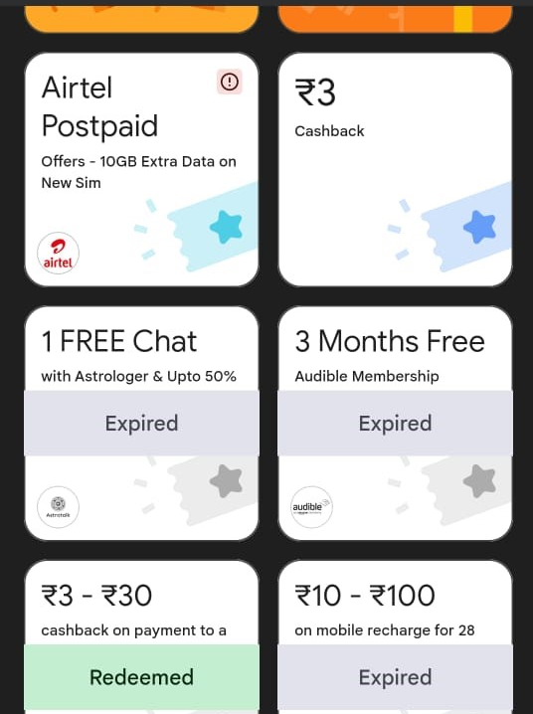
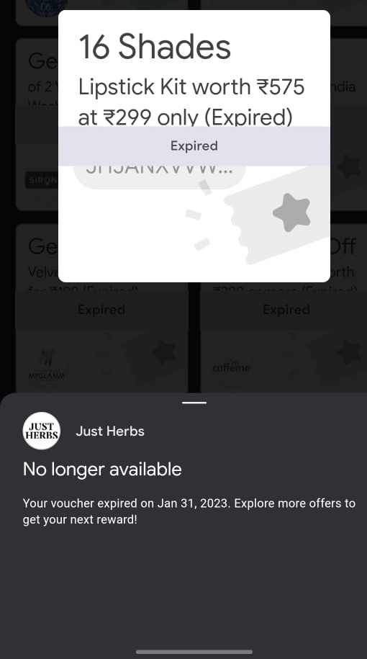
EXISTING SYSTEM

Slide 8
EXISTING SYSTEM CON… Drawbacks :
Wastage of coupons.
Individual sharing.
No alerts regarding the coupons deadline.
One way Communication

Slide 9
PROPOSED SYSTEM
We can also develop interactive web apps and make it hosted in an public environment. Website provides more interactive UI and easy to use for users.
We can also implement filter such a way that user view voucher of their interest and also get a notification on their profile and email when someone added a voucher of their interest.
We will include verification of vouchers.
User Profile Building (Based on Contribution).

Slide 10
PROPOSED SYSTEM CON… Features:
Register and login functionality of users.
All available vouchers can be seen
Buy and update vouchers
Advantages:
Better usage of coupons.
Multiple sharing of coupons.
Efficient alert system for expiring coupons.
Having competitive user profiles with contributions mechanism

Slide 11
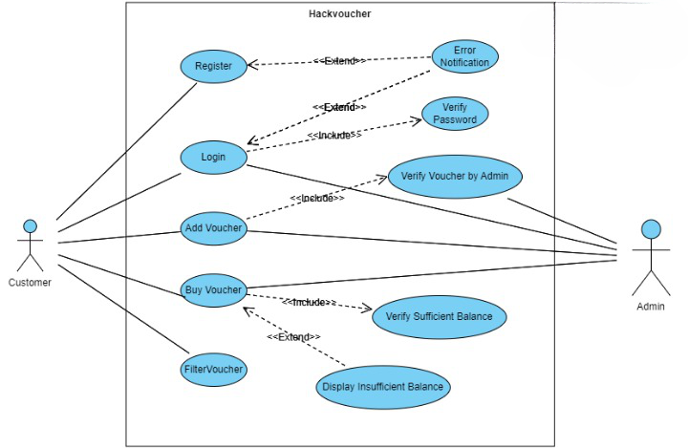
PROJECT DESIGN
Use Case Diagram of Hach-Voucher:
• A Use Case diagram is a type of behavioral diagram defined by and created from a use case analysis.
• Actors – Customer, Admin
• Use Cases – Register, Login, Add Voucher, Buy Voucher, Filter Voucher, Error notification, verify password, verify voucher by admin, verify sufficient balance, display insufficient balance

Slide 12
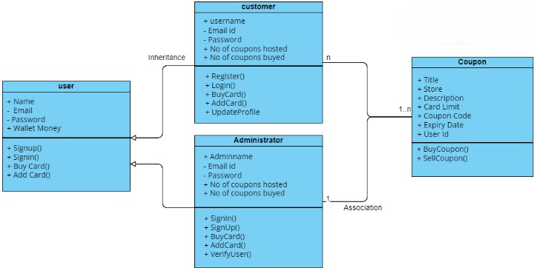
PROJECT DESIGN
Class Diagram of Hach-Voucher:
• A Class Diagram is a type of static structure diagram that describes the structure of a system.
• It shows the classes, attributes, operations and the relationships between them.
• Classes – User, Customer, Coupon, Administrator

Slide 13
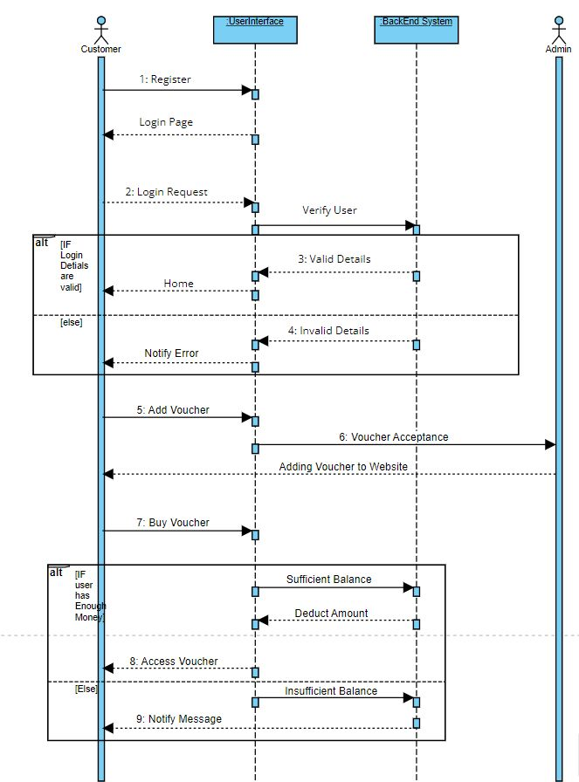
PROJECT DESIGN
Sequence Diagram of Hach-Voucher:
• A Sequence Diagram is a kind of interaction diagram that shows how processes operate with one another and in what order.
• Lifelines – UserInterface, BackEndSystem

Slide 14
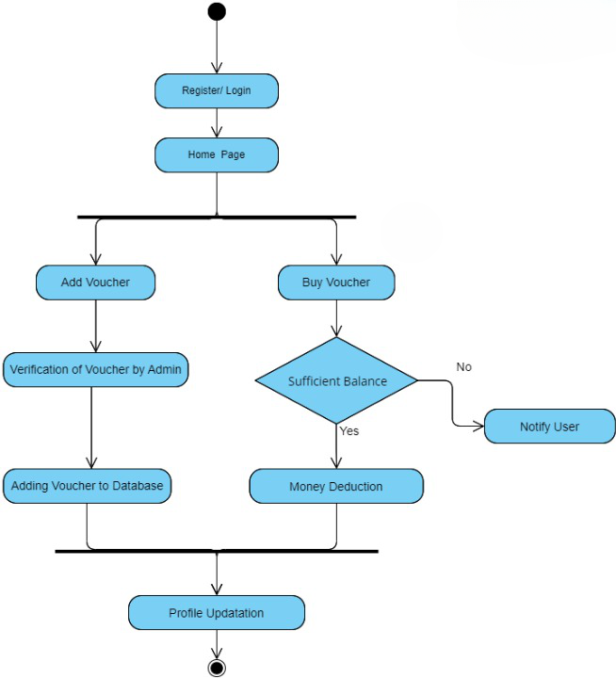
PROJECT DESIGN
Activity Diagram of Hach-Voucher:
• Activity Diagram is a graphical representation of workflow of stepwise activities and actions.
•Actions – Register/Login, Homepage, Add voucher, Buy voucher, verification of voucher by Admin, Adding voucher to database, Money Deduction, Notify User, Profile Updation.
• Decision – Sufficient Balance.

Slide 15
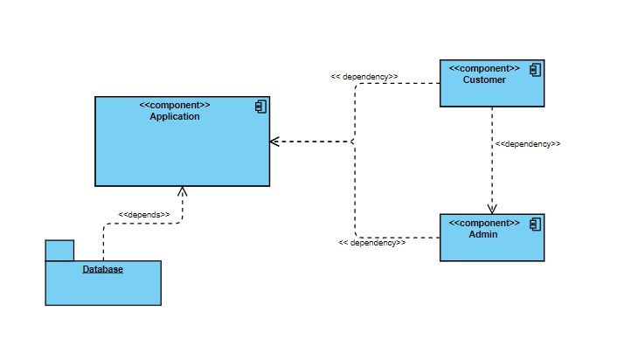
PROJECT DESIGN
Component Diagram of Hach-Voucher:
• A Component Diagram represents the components of a system.
• Components – Application, Customer, Admin
• Package – Database

Slide 16
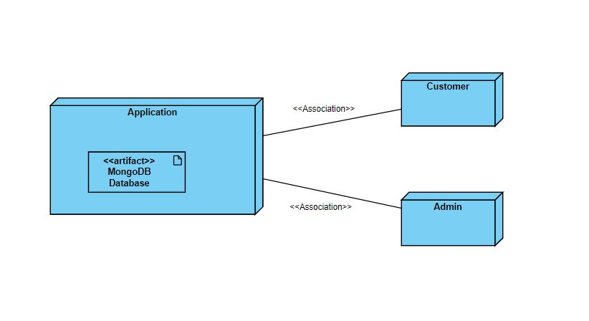
PROJECT DESIGN
Deployment Diagram of Hach-Voucher:
• A Deployment Diagram represents the deployment view of a system.
• Nodes – Application, Customer, Admin
• Artifact – MongoDB database

Slide 17
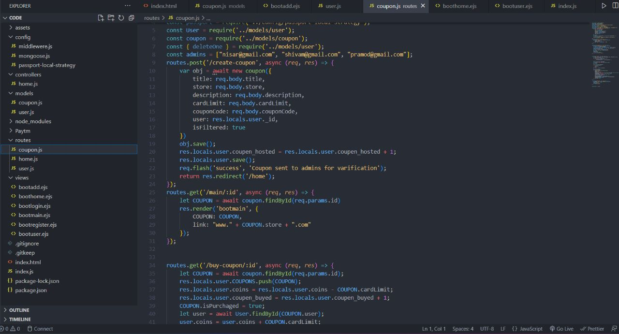
PROJECT CODE

Slide 18
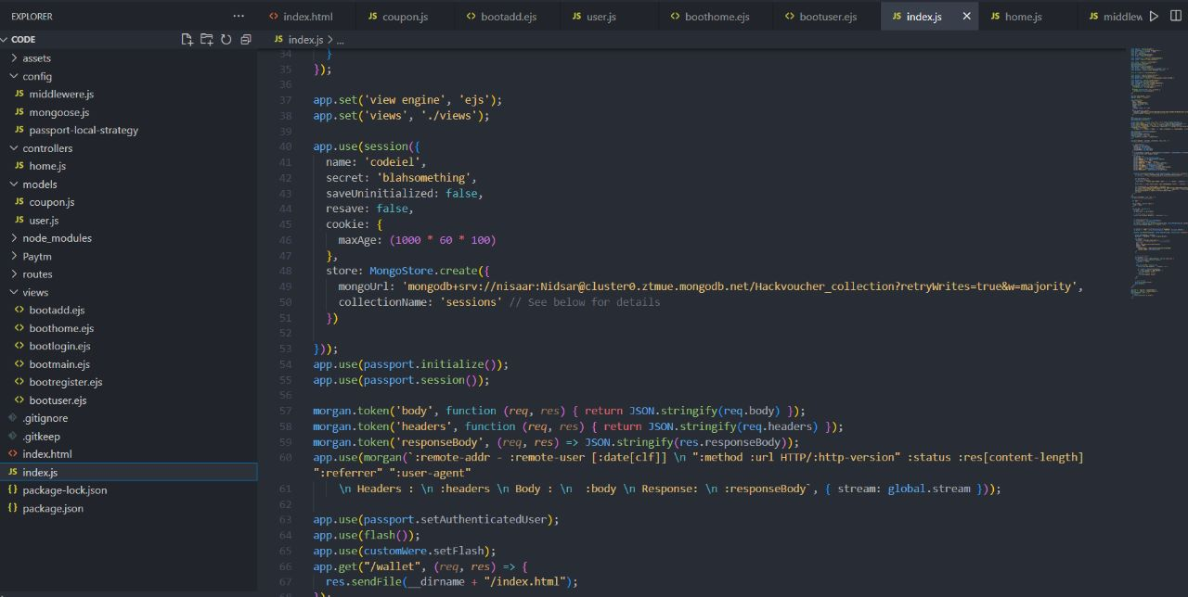
PROJECT CODE CONT…

Slide 19
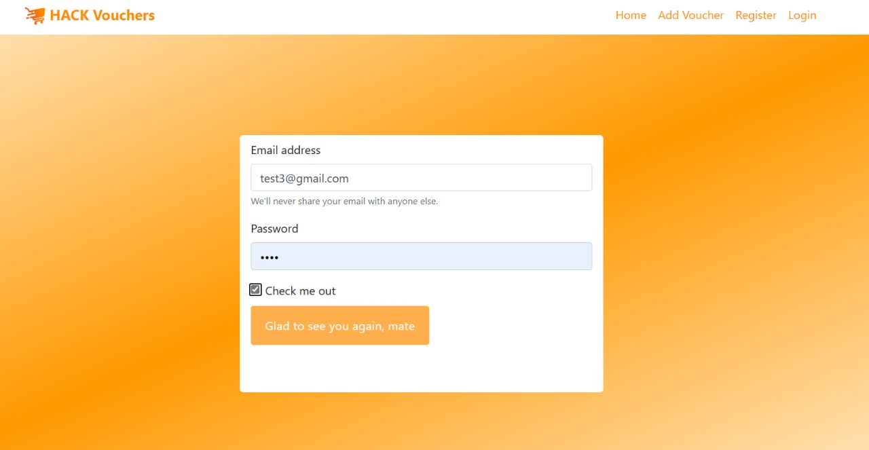
CODE TESTING
Unit Testing
• Unit testing is testing the smallest testable unit of an application.
• It is done during the coding phase by the developers.
• Unit Testing helps in finding bugs early in the development process.

Slide 20
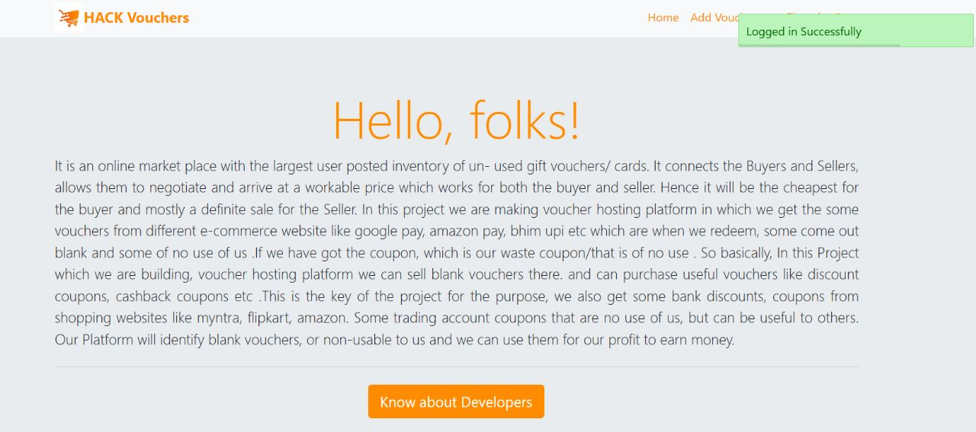
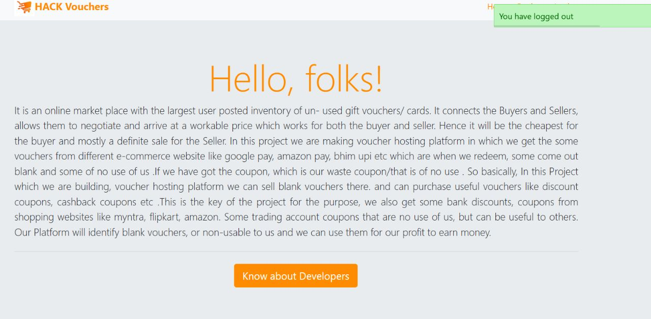
CODE TESTING CONT... Unit Testing

Slide 21
CODE TESTING CONT... Test cases for login and Registration
SNO | Email | Password | Result
1 | Valid | Valid | Successful login
2 | Valid | Invalid | Error: Invalid Pass/mail
3 | Invalid | Valid | Error: Invalid Pass/mail
4 | Invalid | Invalid | Error: Invalid Pass/mail

Slide 22
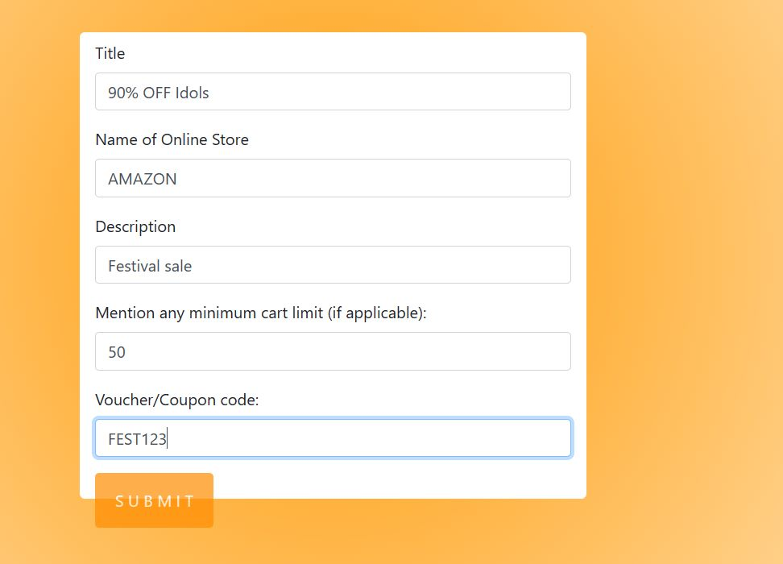
CODE TESTING CONT...
Integration Testing
• Integration Testing is a type of software testing in which the different units, modules or components of a software application are tested as a combined entity.
• It helps in identifying integration issues between the modules and also ensures that the integrated modules work properly before moving to the system testing of the complete application.

Slide 23
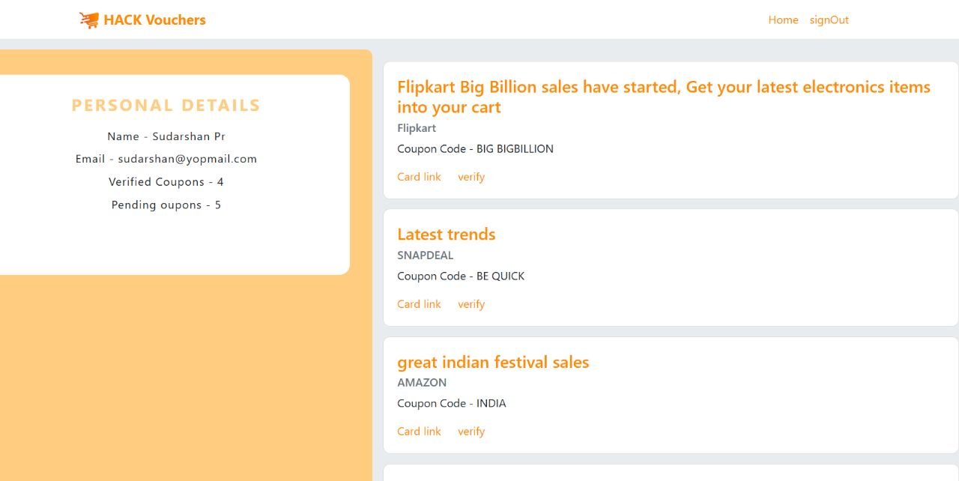
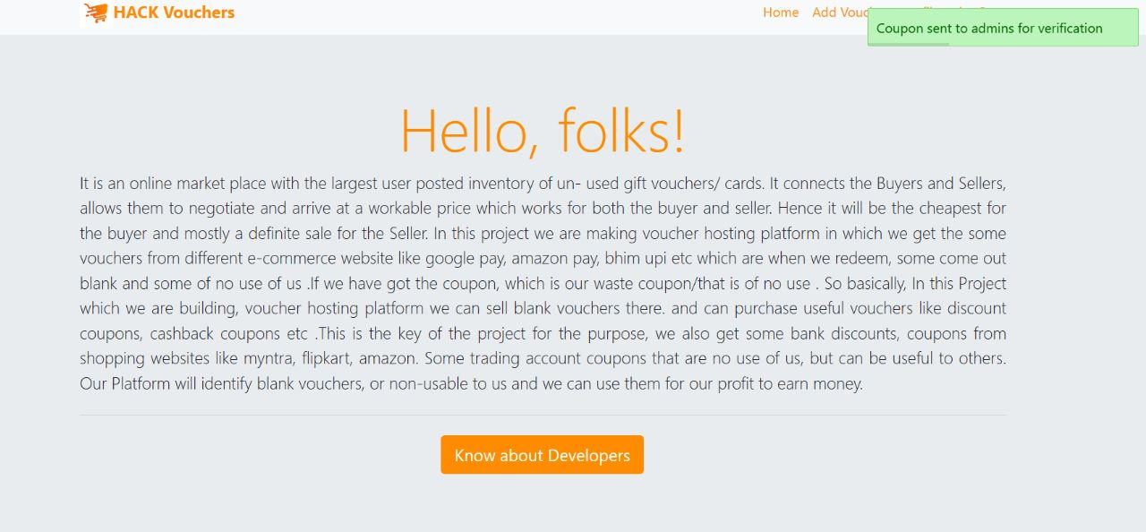
CODE TESTING CONT... Integration Testing

Slide 24
CODE TESTING CON…
System Testing
System Testing evaluates the overall functionality and performance of a complete and fully integrated software solution.
It tests if the system meets the specified requirements and if it is suitable for delivery to the end-users. This type of testing is performed after the integration testing and before the acceptance testing.
The testers do not require more knowledge of programming to carry out this testing.

Slide 25
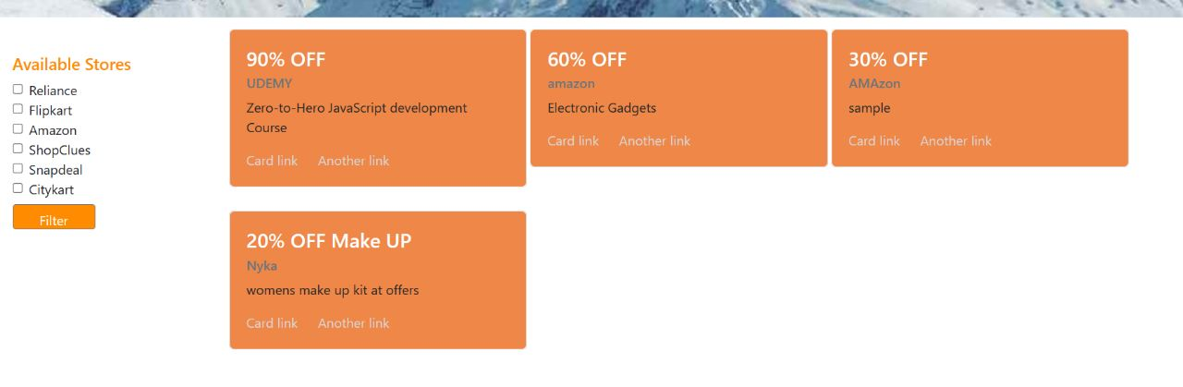
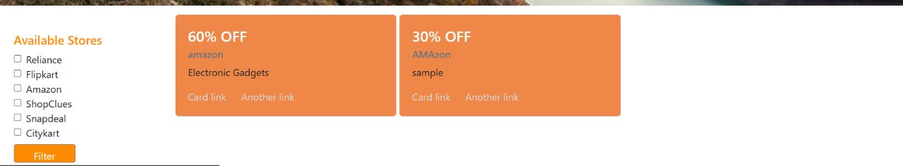
CODE TESTING CONT... System Testing

Slide 26
CODE TESTING CON…
Acceptance Testing
• Acceptance Testing is a method of software testing where a system is tested for acceptability.
• The major aim of this test is to evaluate the compliance of the system with the business requirements and assess whether it is acceptable for delivery or not.
• This testing helps the project team to know the further requirements from the users directly as it involves the users for testing.

Slide 27
CONCLUSION
The end result of the mentioned methodology and planned action will be a highly interactive UI with working functionalities of a Hack -voucher, which will keep user data secure and will be able to handle customized coupon/gift card search for an user. This web application aims to eliminate the wastage of unused vouchers/gift cards. We also get some bank discounts, coupons from shopping websites like myntra, flipkart, amazon. Some trading account coupons that are of no use to us, but can be useful to others. Our Platform provide users coins in exchange of money that is our profit to earn money.

Slide 28
REFERENCES
International journal of scientific & technology research volume 8, issue 08, august 2019 ISSN 2277-8616
https://www.researchgate.net/publication/283699248_Gift_cards_a_review_and_research_agenda
https://www.persistencemarketresearch.com/market-research/gift-card-market.asp
https://stackoverflow.com/
Public opinion on Security of Data from companies, November 2019, Brooke Auxier, Lee Rainie, Pew Research Center.Online Learning

Slide 29
THANK YOU

